Slide 1
SQL Bootcamp
Saving Data – The importance of the transaction log

Slide 2
The bootcamp
Practical understanding of SQL Server
How it works
How you use it
How to get the most out of it
How to detect when it goes wrong

Slide 3
Bootcamp series
Saving data – How SQL ensures no data is lost
Write ahead log, Dirty pages, Checkpoint, Mixed Durability
Locking
Blocking, Deadlocks, Isolation Levels, Dirty Reads (NOLOCK)
Query Execution
Statistics, Plans, Parametrisation, SET options
Performance – Resolution
Clustered - Non clustered, Finding problems, ORMs, Blocking
Performance – Analysis
DMVs, SQL Sentry, SSMS, Perfmon, Extended Events, Linked Servers
TSQL fundamentals
Linked Servers, Window functions, CLR, Spatial Data Types
Security
Encryption, Logins, Certificates, Proxies, Signed procs

Slide 4
Saving Data

Slide 5
Why?
How SQL stores data and how it persists that data impacts everything about SQL
Understanding this enables you to understand
How consistency is maintained
Impact of wide tables, lots of indexes, heaps and clustered indexes on reading and writing
How queries work and why performance can be poor
Concurrency

Slide 6
Agenda
Anatomy of database files
How data is changed ensuring consistency
What happens when things fail
Impact of concurrency
The impact of database design on writes

Slide 7
The anatomy of a database
Data files and transaction log
ALL data is stored in 8k pages
8 Pages group into an Extent
Extents stored in a file
Pages used to stored additional information
Page Free Space (PFS), Global allocation map (GAM), Shared global allocation map (SGAM), Index allocation map (IAM)

Slide 8
The anatomy of a database
Database File
Extent = 8xPages
1
2
3
4
5
6
7
8
9
PFS
GAM
Boot
SGAM
Boot – Boot Page
PFS – Page Free Space
SGAM – Shared Global Allocation Map
GAM – Global Allocation Map
IAM – Index Allocation Map
Transaction Log
VLF
VLF
VLF
VLF

Slide 9
Structures to Files
Structure
Structure
Structure
Structure
Structure
Structure
Structure
Structure
Structure
Structures
Structure
Structure
Structure
Heaps
Indexes
Non-Clustered
Clustered
Column Store
LOB Data
Filegroup
Filegroup
Filegroup
File
File
File
File
File
File
File
File
File

Slide 10
Write Ahead Logging
The transaction log is record of truth
Changes are written to the log and the in data page in memory
The data is NOT written to the data file as part of the transaction
The log is used to rollback transactions
The log is used for recovery of outage

Slide 11

Diagram of QE to Storage Engine (Read)
Query Optimizer
Read Query
Parse
Bind
Results
Optimize
Execute
Storage Engine
Buffer Manager
Log Buffer
Memory
Buffer Pool
Log File
Disk
Data File
…….

Slide 12

Diagram of QE to Storage Engine (Update)
Query Optimizer
Update Query
Parse
Bind
Results
Optimize
Execute
Storage Engine
Transaction Services
Buffer Manager
Log Buffer
Memory
Buffer Pool
Checkpoint/
Lazy Writer
Log File
Disk
Data File
VLF1
VLF2
…….
…….

Slide 13
Write Ahead Logging
Query hits SQL
SQL finds the data to modify, puts pages in memory
Changes made to the in memory data page
And recorded in the log buffer (in memory)
On commit, log buffer written to transaction log
Writes to log are sequential
Once written NOTHING should touch that part of disk
Data is NOT written to data files until later checkpoint

Slide 14
WAL Protocol
Principle
Log Data is written and then not modified
Data is stored in sectors on a disk
Thus
writes must be whole sectors
writes are sequential to a file
If not whole sectors then a second write could corrupt a previous write

Slide 15
WAL Protocol
Log buffer
Tran 2
Tran 1
512 (4k) disk sectors
Log File
The second write, writes to the same sector as the first.
If that IO fails it may have corrupted the first write.

Slide 16
WAL Protocol
Padding added
Log buffer
(max 60k)
Tran 1
Tran 2
512 (4k) disk sectors
Log File
The writes are aligned to a sector boundary.

Slide 17
What’s recorded in the log
Logging has two forms:
Logical operation
Before and after “image” of the altered page
The log stores enough to redo or undo any operation
Redo is required for recovery (after a failure)
Undo is a rollback
Rollbacks are also logged
Space is reserved to ensure a rollback can be completed

Slide 18
Demo
Demo fn_dblog

Slide 19
Log Buffer
The complete log buffer is flushed to disk on commit
The log writer performs the flush
There is only one process per server, but buffers are per database
The buffer may contain other non committed transactions
Each buffer is up to 60k
Large data modifications will cause the buffer to flush before the commit
User processes showing the WRITELOG wait type are being held up buffer flushes, possible bottleneck at disk

Slide 20
Demo
Demo1 – Transactions and logging
Notes:
SabinIO.Logging.Demo1
SavingData\SabinIO.Logging.WithTran\Demos\1. WithorWithout.sql
SavingData\SabinIO.Logging.WithTran\Demos\2. ViewCounters.sql

Slide 21
Demo Summary
Each commit needs to flush buffer
Minimum write is 512 or 4k (disk sector size)
Maximum is 60k
Quicker to do batches than small transactions
(maybe)
IOPS for drive is critical

Slide 22
Data File Writes
Dirty data pages are written to disk by either:
Checkpoint
Lazy Writer
Checkpoints are a marker in the log to indicate there are no dirty pages previous to the marker

Slide 23
Checkpoints
Fired when:
Automatically in background by the server, intervals will vary
Timing is based upon the “recovery interval” or Target Recovery Time
Simple databases at 70% log full
Also truncates the log (frees up space)
Other types of Checkpoint:
Indirect – caused by database backups, snapshots and cluster failovers, shutdowns, detach DB
Manual – user invoked checkpoint

Slide 24
Lazy Writer
Invoked due to memory pressure
Background process that writes dirty pages to disk
Tries to write continuous pages (up to 32)
Can write pages where the change has NOT been committed
Page is latched
No users can modify it until the write is complete
Reads continues

Slide 25
Demo
Dirty Pages
Notes:
Dirty pages
Demos 1 and 2 WriteLogTest and IncompleteTransation

Slide 26
What if things go wrong
To recover you need
Only have the Data File = new job
What do you have | Recovery Point
Data files + the transaction log | Time of failure
Data Backup | Time of data backup
Data Backup, Tlog backup | Between time of data backup and Tlog backup
Data Backup, Tlog backup + old transaction log | Between time of backup and time of failure

Slide 27
Transaction Log = Point in time restore
No active transaction log or backup
No point in time recovery
No Database backup
No recovery
Broken sequence of Tlog backups
Recovery to point of break
Transaction log backed up to protect the log
Avoid excessive growth
Simplify the database restore

Slide 28
Recovery
Performed during the startup of the server/database
Or after restore of database and transaction log
Ensures the consistency of the database before users can access it
3 Phases
Log Analysis – find the last checkpoint (known good state)/first active VLF
Redo – Looks for committed pages that were not flushed to disk before the last shutdown.
Undo – Rollback any uncommitted transactions that have been flushed to disk

Slide 29
Demo
Restore log sequence
Notes:
No Demo for this – Can just use Management Studio

Slide 30
Snapshot restore
Restores a database from a snapshot
Replaces pages that have changed
Snapshot database files only contains pages that have changed
For testing very quick
Especially for large databases
Avoids IO of reading whole backup and restoring whole database
Changed data should be a fraction of total database size

Slide 31
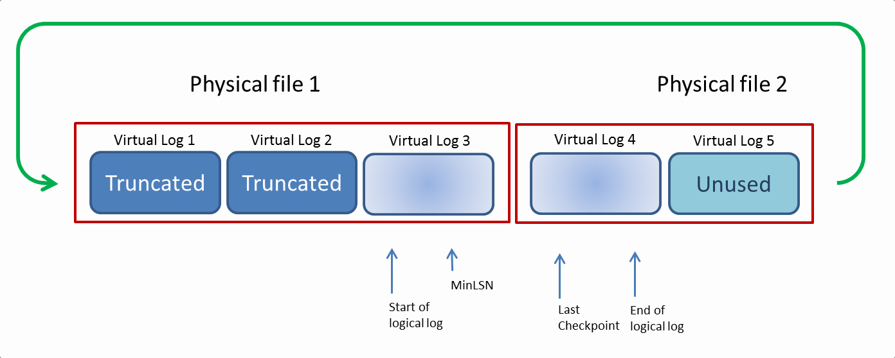
Log Structure
Contains multiple Virtual Log Files (VLF’s)
These vary in size and number
Writing to the VLF is always sequential for performance
At the end of the last VLF it loops back to the first available VLF
Any VLF post the last checkpoint is considered the active portion

Slide 32
Demo
Notes:
SabinIO.Logging.VLFsDemo2

Slide 33
Log reuse
Sequentially written
If you don’t clear space at the start
Your log will grow
If it can’t grow ?
Your database will stop

Slide 34
Clearing the Log
Cleared by a backup
Features that block log truncation
Replication
Mirroring
CDC
Open Transactions
Backups
See sys.databases log_reuse_wait_desc

Slide 35
Data Integrity
Page Verification
None
Pages are trusted to be valid, totally corrupt pages still cannot be read
Torn Page
Places a bit marker every 512 bytes to show page was fully written
Checksum (default 2005+)
Creates a checksum of the data and writes to header
On read the checksum is verified
When changing to checksum existing pages will not have a checksum
It will resort to torn page checking if it existed
Fix by reindexing

Slide 36
Demo
Page Verification
Notes:
Demos\SavingData\SabinIO.Recovery.PageVerify\Demos\1. PageVerify.sql

Slide 37
Impact on writes
Log performance is critical
One transaction log per database
More databases = more throughput (if storage can cope)
Memory doesn’t help
Its all about IO

Slide 38
Table size impact
Large data types = more IO
More columns = more IO
Variable length columns = page splits = more IO
More columns => more indexes => more IO
Updates are expensive
Find the data
Store before and after

Slide 39
Concurrency
Everyone is writing to the same buffer
Transaction Log is a bottleneck
Can’t expect to have exclusive access to buffer
Transactions still good for performance

Slide 40
Impact of indexing
More indexes = more IO
More indexes = more complex query plans

Slide 41
Demo
Concurrency performance
Write performance with indexes
Write performance with page splits
Notes:
Demos\SavingData\SabinIO.LogOverhead.Demo\Demos\Demo1.sql

Slide 42
Summary
http://www.red-gate.com/community/books/sql-server-transaction-log-management
http://blogs.msdn.com/b/psssql/archive/2010/03/24/how-it-works-bob-dorr-s-sql-server-i-o-presentation.aspx
http://improve.dk/category/SQL%20Server%20-%20Internals/
http://www.sqlskills.com/blogs/paul/inside-the-storage-engine-anatomy-of-a-page/

